Slide 1
Anthony Mason MCSE SQL Server 2012 Data Platform Director of Software Engineering Therapy Management Corporation Hattiesburg, MS Anthony.Mason1@gmail.com
About Me

Slide 2
Advanced t-sql & SQL Server features

Slide 3
Topics
CTEs
Cross / Outer Applies
Windowing Functions
Lag / Lead
Statistics Options
Grouping Sets
Degrees of Parallelism
SQL CLR
Transparent Data Encryption
Change Data Capture (CDC)

Slide 4
Common Table Expressions
A temporary query with a scope of a single SELECT, UPDATE, DELETE, or INSERT statement
Can be used to organize and simplify complex SQL queries
Pull common elements (subqueries) into a CTE can often improve performance and simplify execution plans

Slide 5
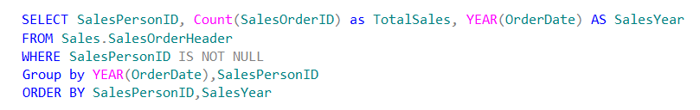
Common Table Expressions
Let’s take a simple example

Slide 6
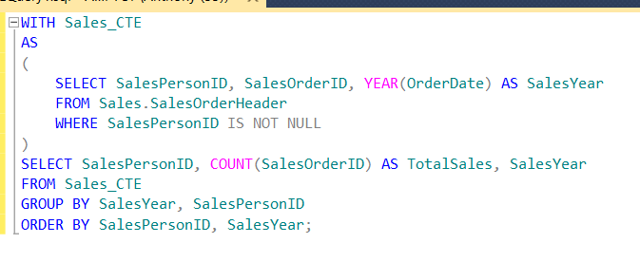
Common Table Expressions
Let’s simplify it to be easier to read

Slide 7
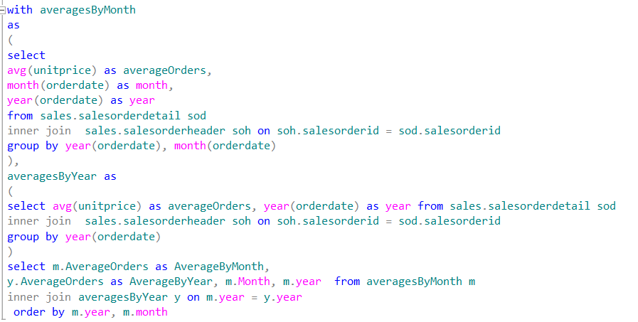
Chaining CTEs

Slide 8
Recursive CTEs
Extremely handy for hierarchy queries and dynamic date ranges
Recursive CTEs are by default blocked at 100 levels of recursion, but you by modify this OPTION(MAXRECURSION N)

Slide 9
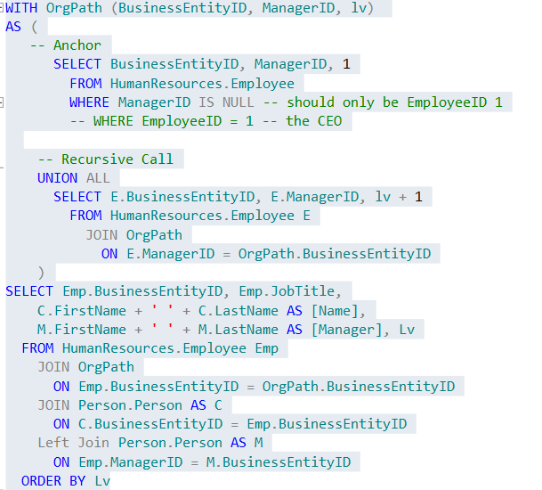

Slide 10
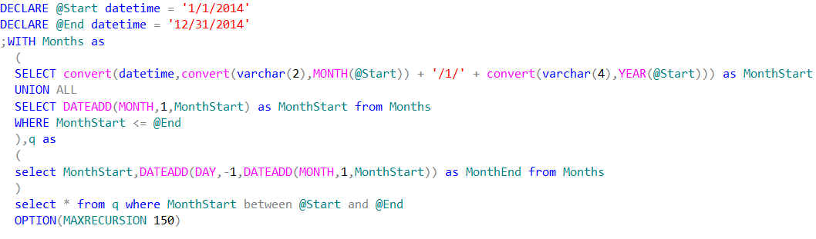
Great for report date ranges

Slide 11
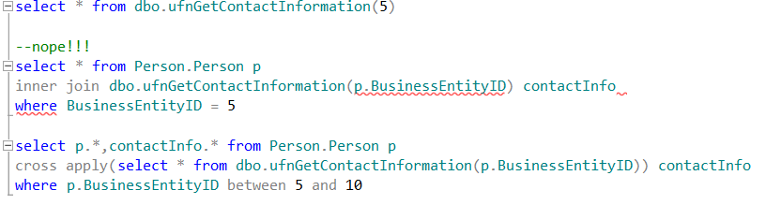
Cross Apply
Think of a cross apply as an INNER JOIN on a table valued function.

Slide 12

Outer Apply
Equivalent of a LEFT JOIN on a table valued function (or inner query)

Slide 13
Windowing Functions
Windowing functions give you greater control over aggregates and ranking functions
Aggregates
ROW_NUMBER
RANK
DENSE_RANK
NTILE

Slide 14
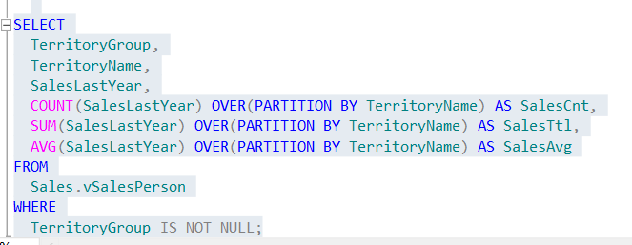
Windowing Aggregates

Slide 15
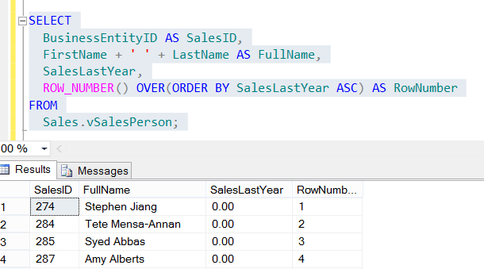
ROW_NUMBER

Slide 16
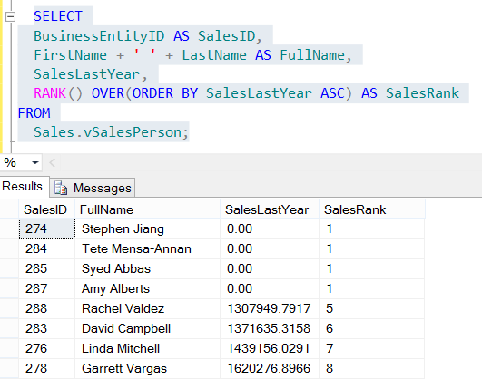
RANK

Slide 17
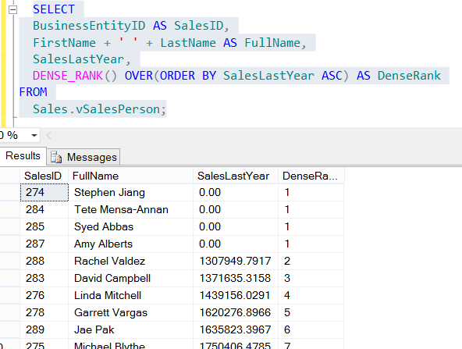
DENSE_RANK

Slide 18
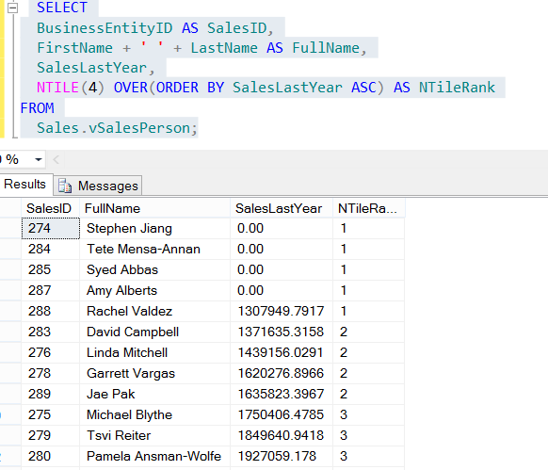
NTILE

Slide 19
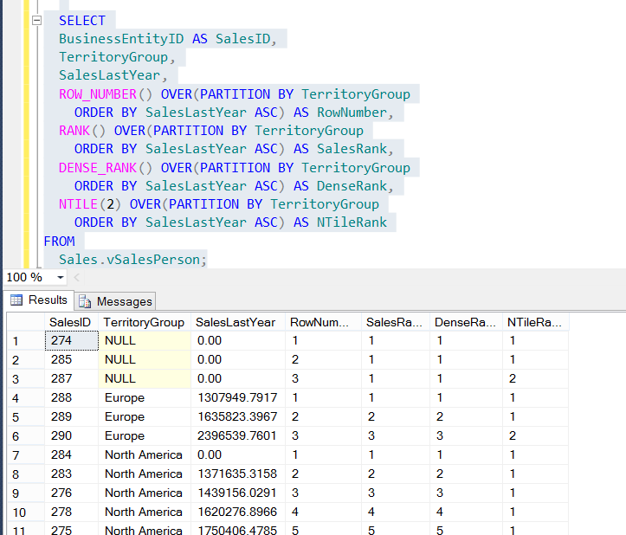
PARTITION BY
Resets the windowing function

Slide 20
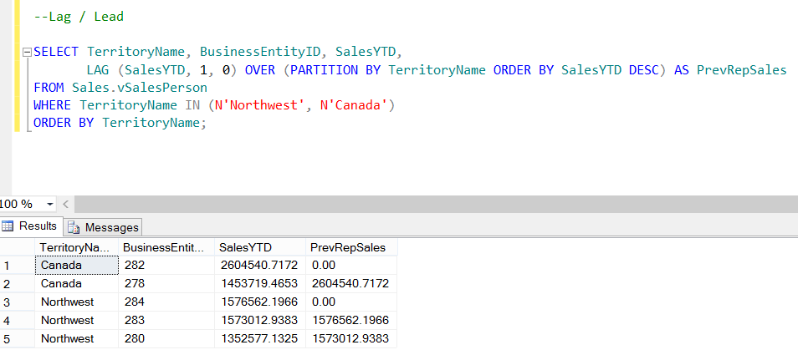
Lag & Lead
New in SQL Server 2012
More efficient way of getting previous / next row values for subtotals

Slide 21
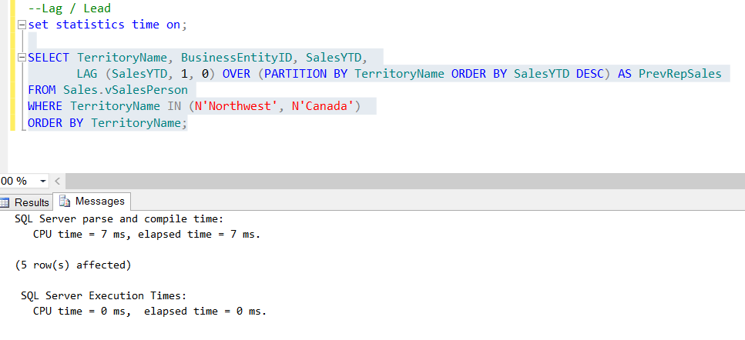
Statistics Options
SET STATISTICS TIME
Handy for looking at millisecond runtimes while rewriting or optimizing queries

Slide 22
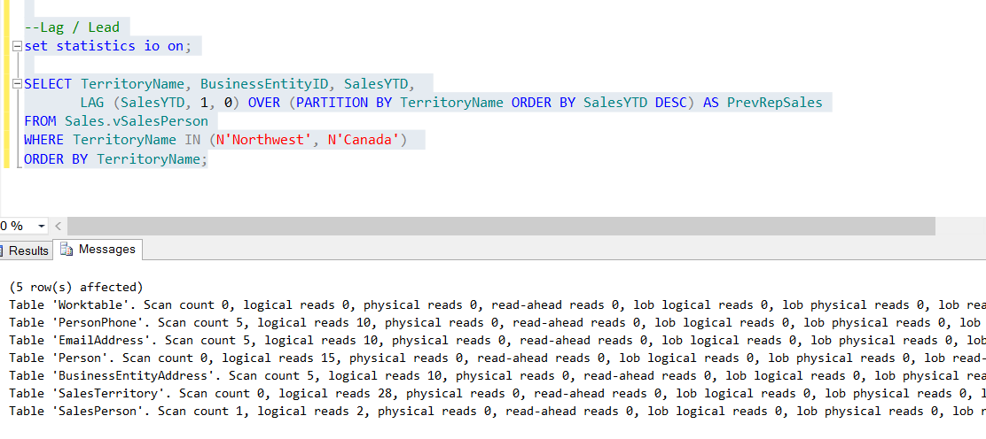
Statistics Options
SET STATISTICS IO ON
Handy for examining disk i/o and reducing physical reads through indexes, CTEs, or temp tables

Slide 23
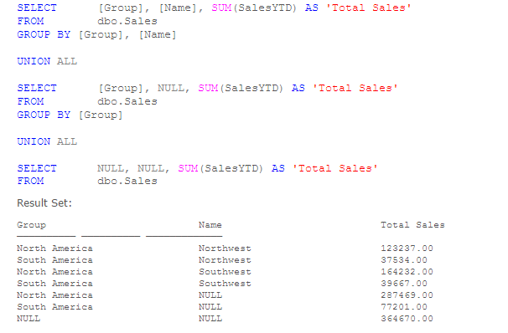
Grouping Sets
Allows you to eliminate unions and subqueries when creating subtotals and grand totals

Slide 24

Grouping Sets
Allows you to eliminate unions and subqueries when creating subtotals and grand totals
Can also give you the results as GROUP BY ROLLUP, GROUP BY CUBE, but with cleaner syntax (personal preference)

Slide 25
MAX DOP
Maximum Degrees of Parallelism
Gives you custom control over how many threads (cores) a particular query can split off to, according to its execution plan
Can set it on a server wide basis, or on a specific query

Slide 26
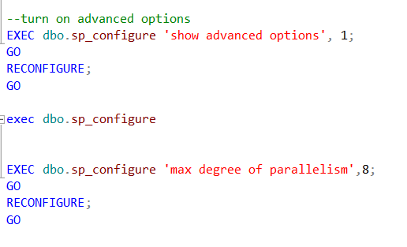
MAX DOP
Changing global server setting:

Slide 27
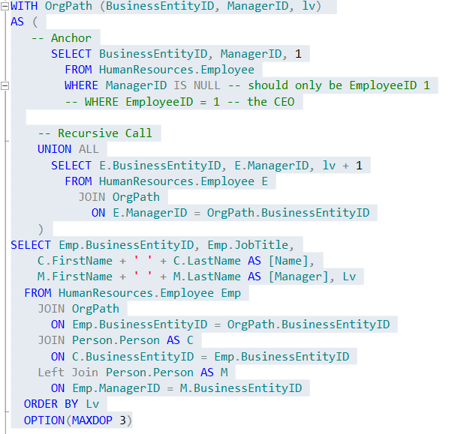
MAX DOP
On a query basis:

Slide 28
SQL Server CDC Change Data Capture

Slide 29
Change Data Capture
An Enterprise-Only level Feature (as of 2012)
Allows you to accomplish the traditional “audit log” in a matter of minutes
Does not depend on triggers
High performance, low-impact

Slide 30
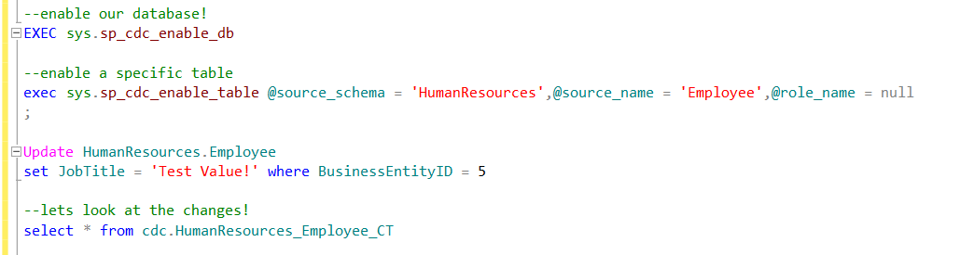
Change Data Capture

Slide 31
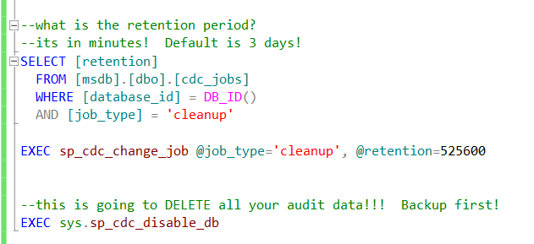
Change Data Capture
Don’t forget to set your retention period!

Slide 32
SQL Server CLR

Slide 33
SQL Server CLR (C#)
Allows you to use a .Net Assembly (i.e. C# / VB.Net code) in SQL
User Defined Functions
Stored Procedures
Custom Data Types
Triggers

Slide 34

SQL Server CLR
Should be used conservatively and cautiously – can easily lead to performance issues, particularly with data-access CLR code, but can still offer performance gains over scalar UDF’s or row-by-row (non-batch) queries.

Slide 35
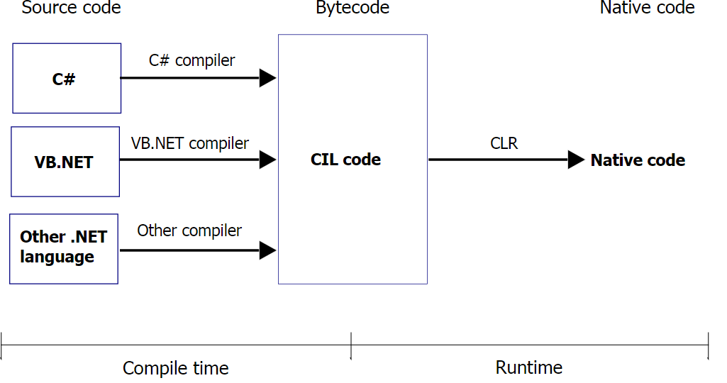
.Net CLR
Microsoft’s implementation of the Common Language Infrastructure
Converted “compiled” .Net Code (bytecode) to Machine Code

Slide 36
Example
SQL Server has a LIKE statement which is powerful and fast, but maybe we just want to use an old fashioned regular expression to pass directly to a report.

Slide 37
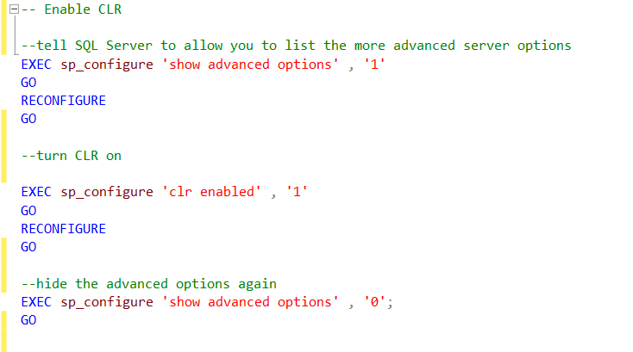
Step 1: Enabling CLR
CLR is not enabled by default!

Slide 38
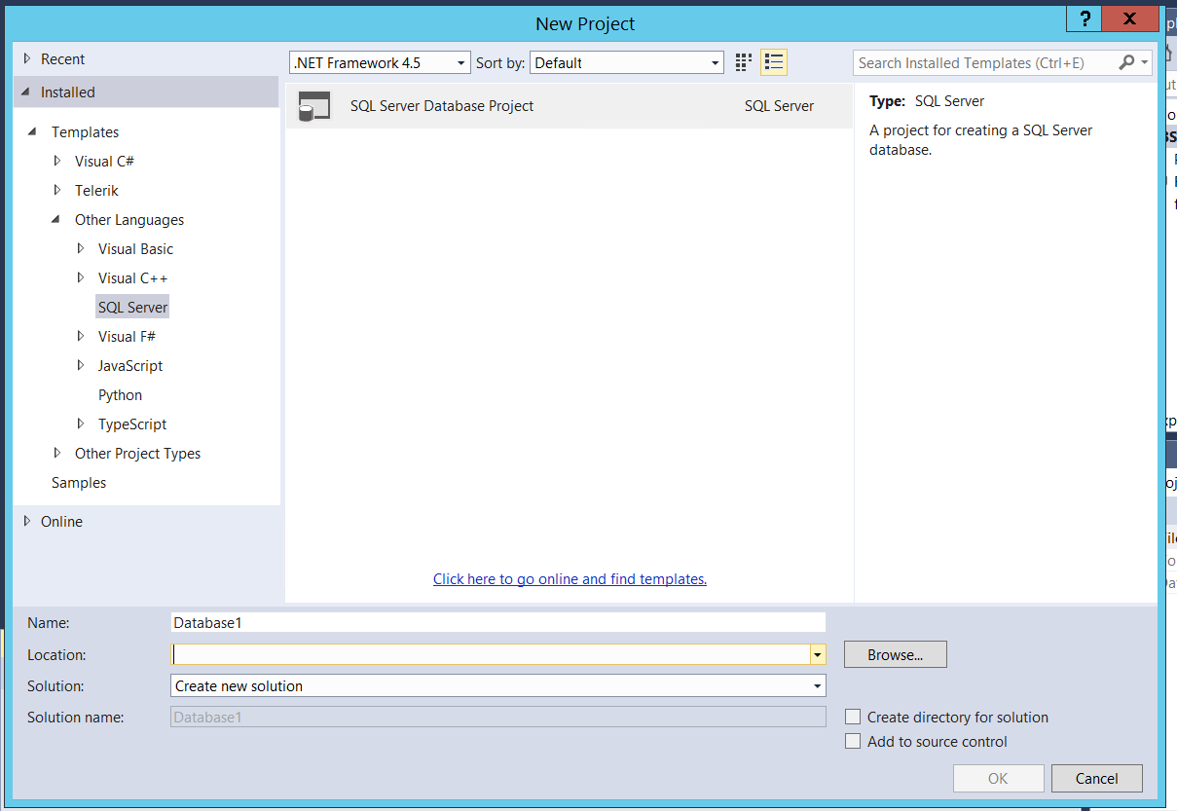
Step 2: Creating Your Project

Slide 39
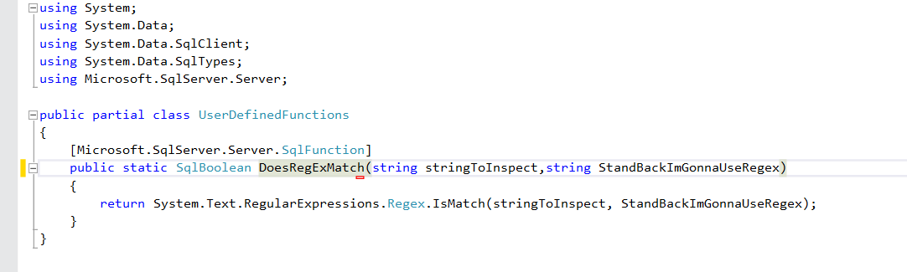
Step 3: Write your code!

Slide 40
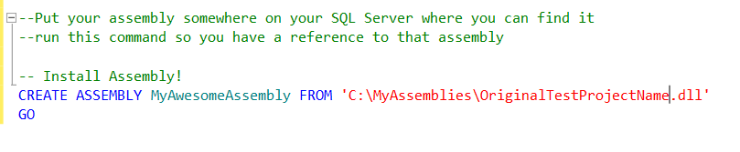
Step 4: Bring Your Assembly Into SQL Server
Your assembly (dll) needs to be on the same machine as your SQL Server service

Slide 41
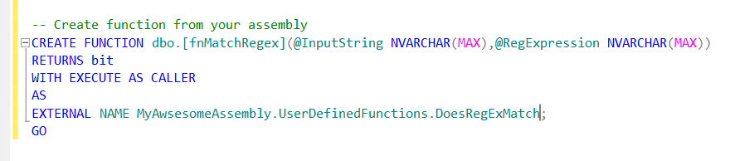
Step 5: Tie your SQL Server object to your assembly

Slide 42
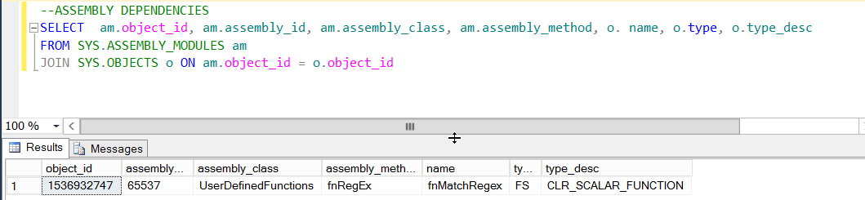


Tips – Handy related SQL
You can’t drop an assembly from SQL Server without first dropping its dependencies
Query Assemblies Registered w/ SQL Server

Slide 43
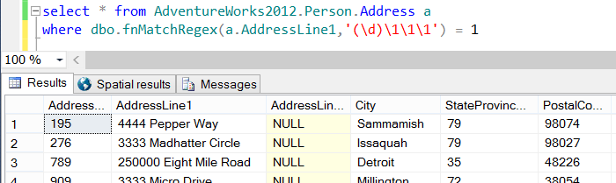
Step 6: Use it!

Slide 44
Transparent Data Encryption (TDE)

Slide 45
SQL Server Encryption (TDE)
“Data at Rest” Encryption
Encrypts the entire database on the disk
SQL Server Enterprise Edition Feature
Requires No Modification to Applications or Code

Slide 46
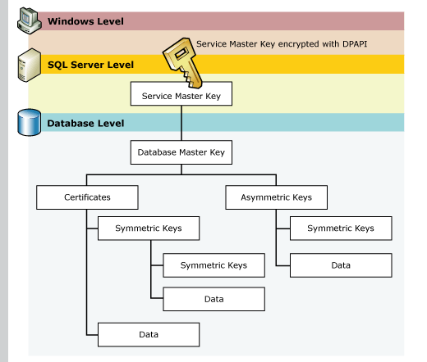
SQL Server Encryption Keys

Slide 47
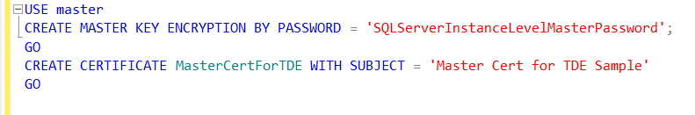
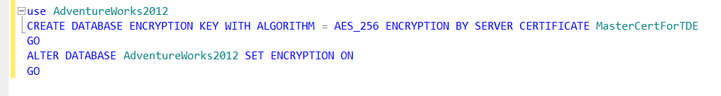
Create Master Level Key
Create DB Level Key & Enable

Slide 48
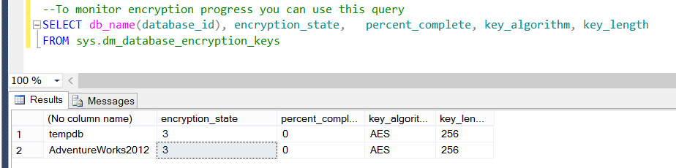
Check on Encryption Status

Slide 49
Questions & Beer Time.

